Slide 1
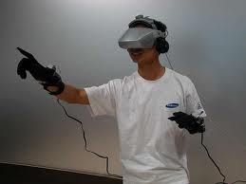
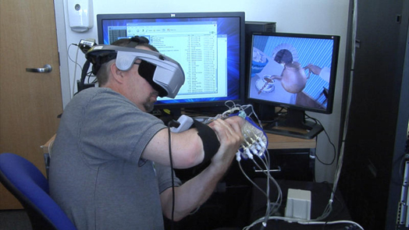
Virtual reality
By: Samuel Salazar
8/29/14
EWSIT
people testing virtual reality gear

Slide 2
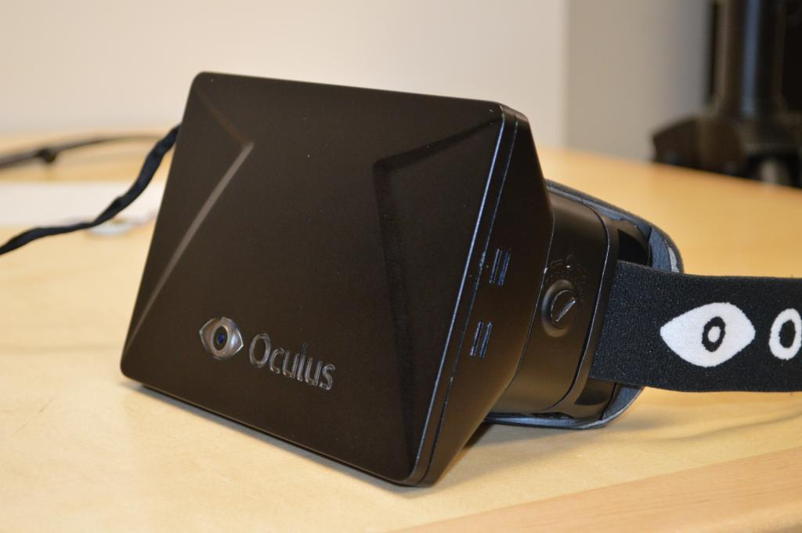
Virtual reality is a revolution in gaming, allowing for the player to experience what is going on instead of just looking at a 2D image.
There are more then one virtual reality machines in existence but the most popular one currently is the oculus rift. The oculus can be paired with certain games but not all are oculus accessible.
A fairly well know youtuber (pewdiepie) playing a game on the oculus
The oculus

Slide 3
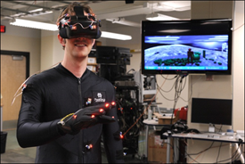
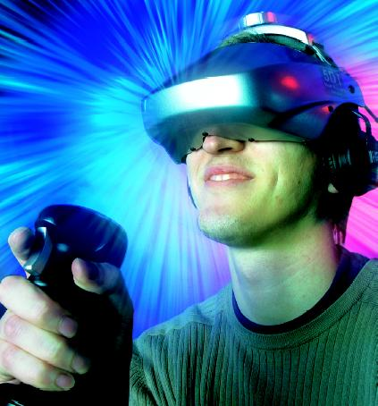
virtual reality works by showing the player 3d images while blocking out everything else making the player think that it’s real since it’s all that there is. Now in developmental stages are virtual reality systems that allow the player to interact with the game just by moving, but currently players still have to use controllers.
People further developing VR
Someone using a VR machine

Slide 4
Jobs associated with virtual reality
There aren’t a whole lot of jobs related to virtual reality, those that do exist break down to two categories: those designing the tech to allow for virtual reality immersion, and those who design and create the software to make certain applications compatible with the virtual reality.

Slide 5
Virtual reality has quite a long way to go before there is complete and total immersion, but it’s making it’s way there steadily. Using virtual reality for video games is just scraping the surface, it could be used to train soldiers in realistic combat situations and much more.
Sources: http://electronics.howstuffworks.com/gadgets/other-gadgets/virtual-reality.htm
http://electronics.howstuffworks.com/gadgets/other-gadgets/VR-gear.htm

