Slide 1
History and Impact of SciVis the power point section
Samuel salazar

Slide 2
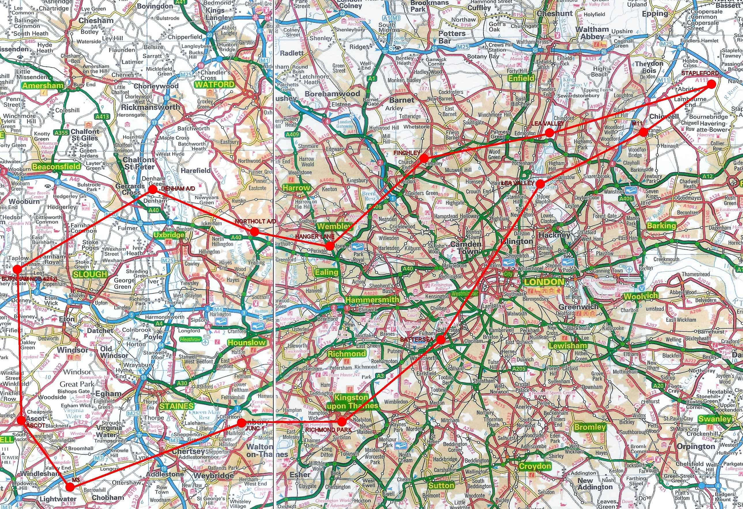
road maps show different routes you can take to get to different places usually used on long road trips when one doesn’t know the route

Slide 3
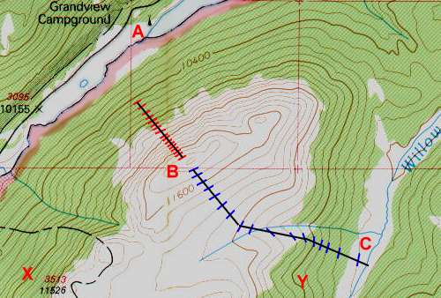
topographic maps show the different depths of different areas usually used when planning buildings, bridges, etc.

Slide 4
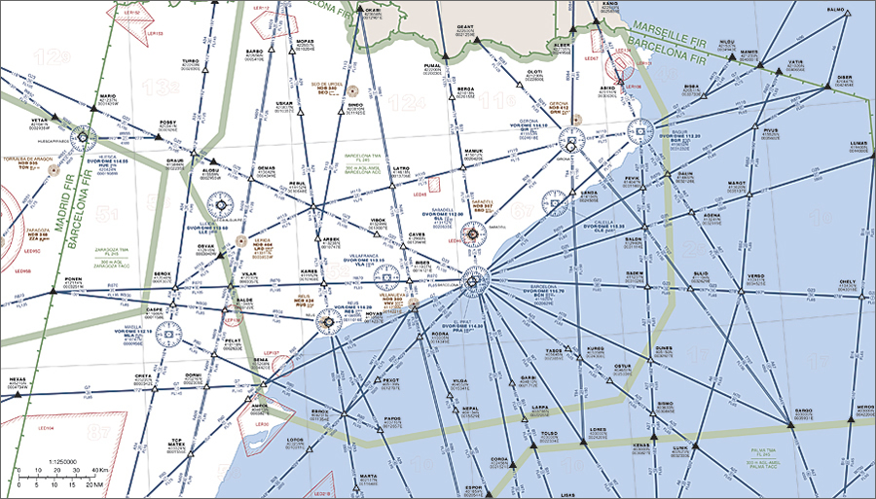
aeronautical maps are basically road maps for planes, they tell them the route they need to take to get to their destination. They are used by pilots.

Slide 5
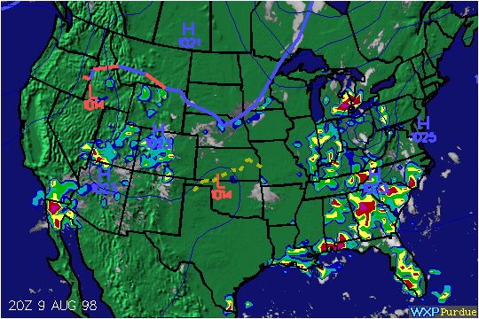
Weather maps are maps that show what areas are experiencing certain types of weather, usually used by meteorologists.

Slide 6
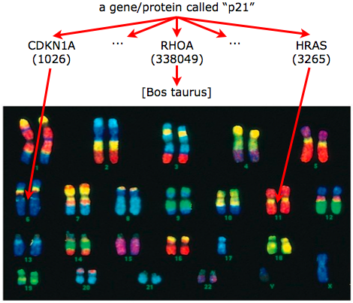
a gene map is a map that shows your genetic data, usually used by doctors.

Slide 7
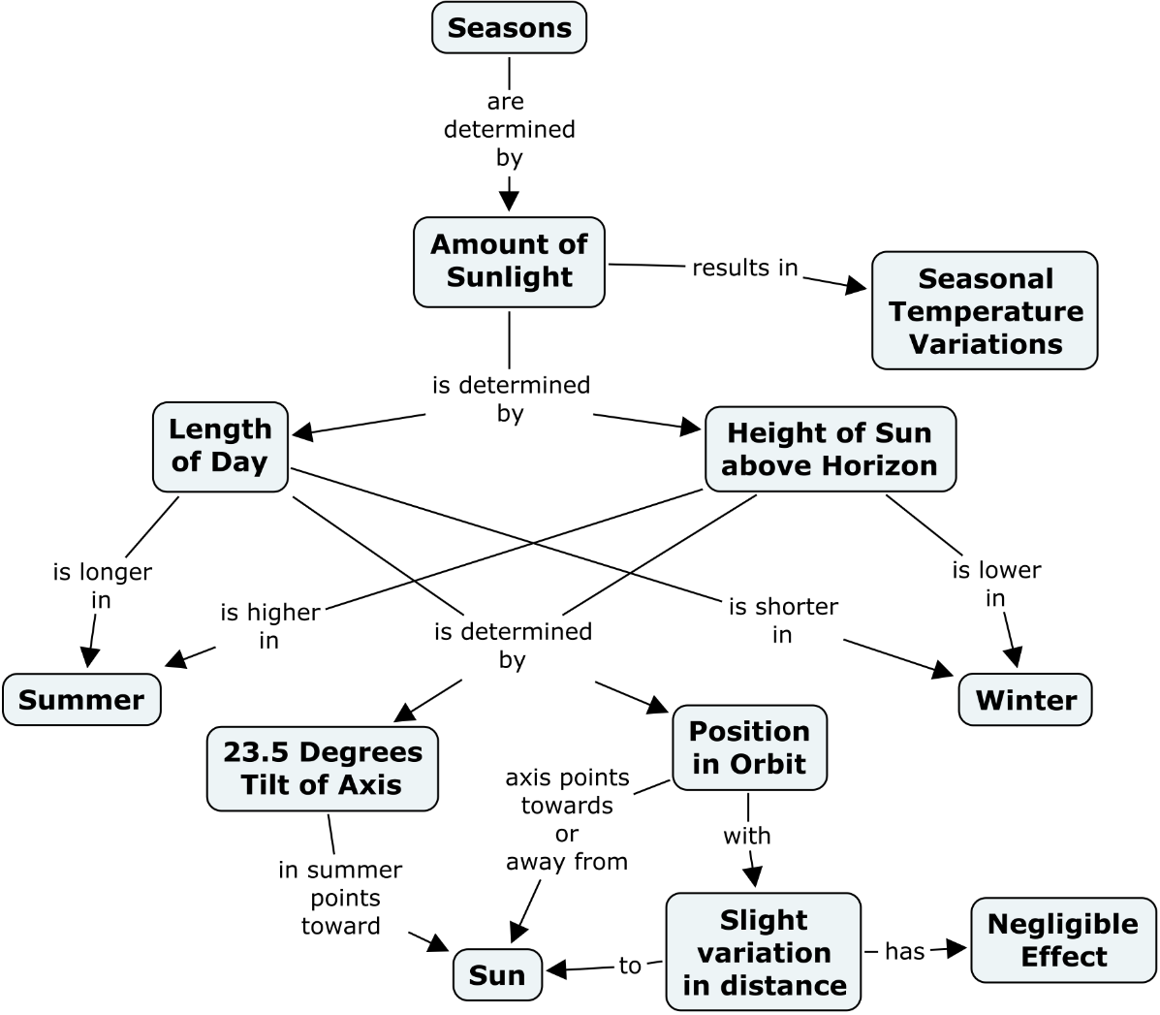
concept maps are maps that you take an idea and elaborate on the idea thus creating the map, usually used by students

Slide 8
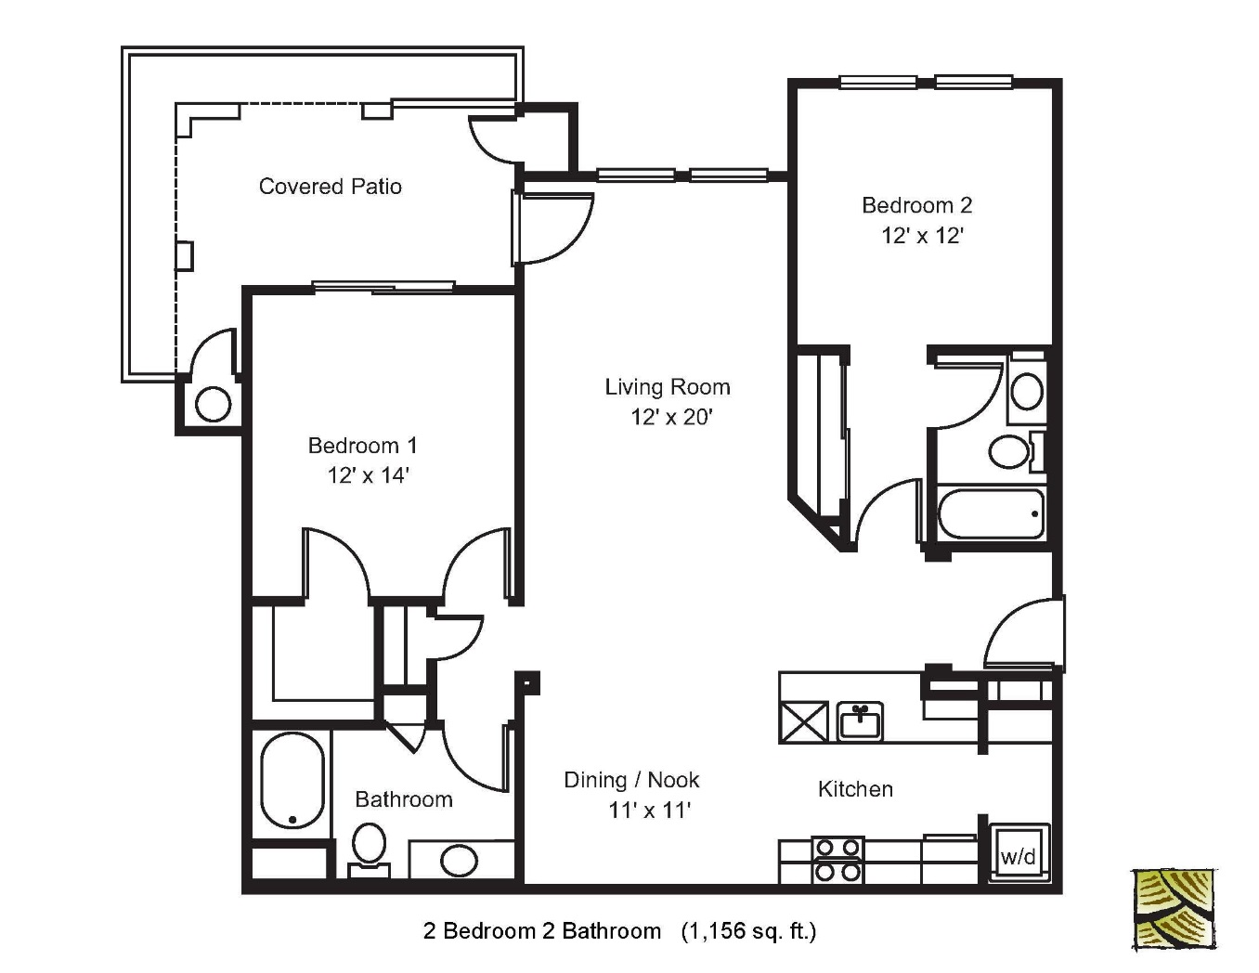
a floor plan is a 2D rendering of your house, usually used by architects

