Slide 1
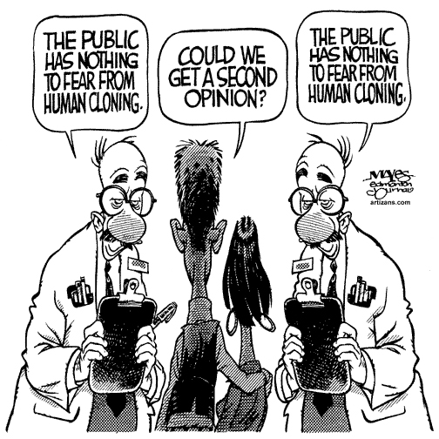
Cloning
By Ben Calabrese, Samuel Salazar, and
Carson Broyles

Slide 2
What is cloning?
Cloning is the process of producing genetically identical individuals (Animal or Human) that occurs in nature when organisms reproduce asexually.

Slide 3
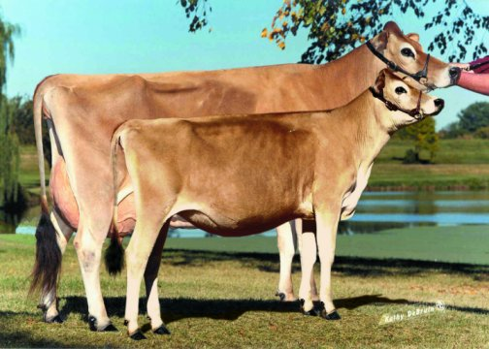
How does Cloning work?
The term “cloning” generally applies to a process also known as “Somatic Cell Nuclear Transfer”.
The DNA from the cell of an adult animal, called the “donor”, is taken from the cell, and placed into an egg cell from another type of the same animal.
A few steps later, and the newborn will be an identical genetic replica to the donor cow. Although it sounds easy enough, such a task takes many attempts to succeed.

Slide 4
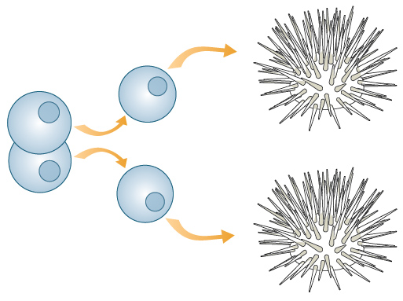
First ever artificial embryo twinning
It all started in 1885, Edward Dreisch had separated a sea urchin’s embryo cell, and placed it into another sea urchin’s embryo, and it grew into the full sea urchin
This showed that each cell in the early embryo had it’s own set of DNA to grow and start from.

Slide 5
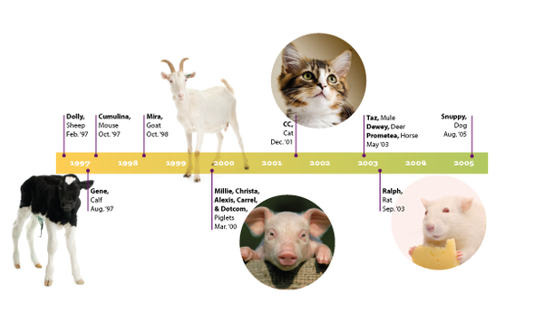
Timeline of Cloning

Slide 6
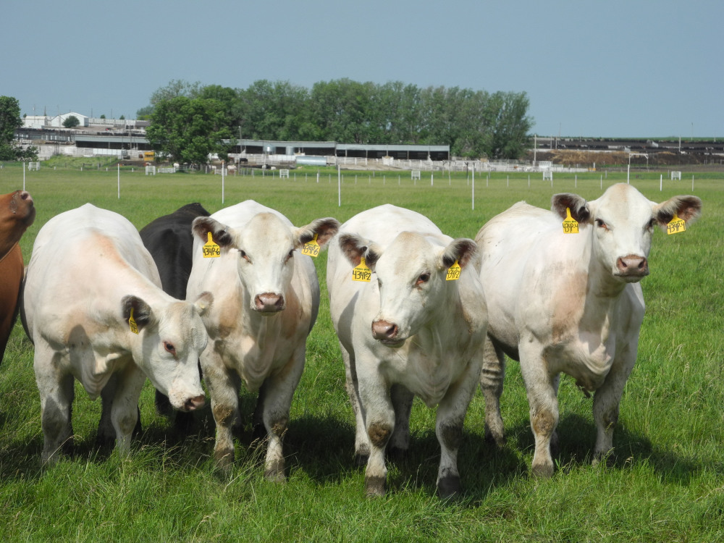
Who would use Cloning?
It turns out, that many companies would clone animals for the production of food/dairy/eggs/etc.

Slide 7
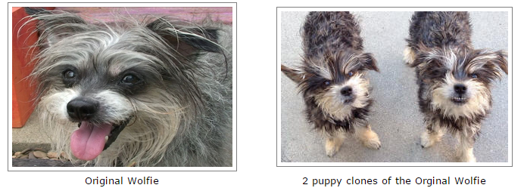
Example of a Cloning Company
This is My Friend Again, a dog cloning company. You can pay a cost of $100,000 to clone your dog, dead or alive (varies if dog is already dead. It can take from 6 months to an entire year to clone your dog, and the cloning takes place in Seoul Korea.

Slide 8
Pros of Cloning
If the sperm of a parent is sterile, and cannot have children, you can still clone a sample of DNA of the female parent, and have a child as if it was naturally born.
One can clone the DNA of an endangered species to produce more of that kind.
Same sex couples can have children without the need of a sperm donor.
Cloning can possibly be used to replace certain organs in one’s body, and will be recognized as such.

Slide 9
Cons of Cloning
A clone will not be the identical copy of the original. The look of the clone will be more of a “twin”, and the clone will not act as the original, it will have it’s own personality.
When attempting to clone, it will most likely not be accomplished the first time, due to genetic defects.
Clones may be seen as less than human in the public compared to non-clones.
Children may be living in a “shadow” of the original human he/she was created from.

Slide 10
People Promoting Cloning
Companies like ViaGen, PERPETUATE, and Cyagra are using to their advantage to either cloning animals for the use of milking, providing meat to retail stores, or just simply taking part in the continuous research for cloning.

Slide 11
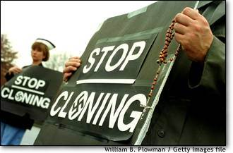
People demoting Cloning
There are many people who very much disapprove of cloning, some even fear the reality of human cloning.
Many believe that cloning is against God’s will, as an average person would be “playing God” or creating human beings without souls.

Slide 12
Future of Cloning
Clones will most likely lack important nutrients when cloned, and will have to visit a pharmacy to get the nutrients the clones were missing.
Sir John Gurdon claims that, within 50 years, human cloning will become possible. The subject of the matter is very controversial.

Slide 13
Sources
www.technologyreview.com/view/411834/the-dark-side-of-cloning/
http://myfriendagain.com/faq/faq.htm
Staff.lib.msu.edu/skendall/cloning/companies.htm
http://io9.com/5949612/why-cloning-is-a-terrible-way-to-bring-your-pet-dog-back-from-the-dead

